Slide 1
Targeted Vocabulary in Russian Textbooks
The project that almost wasn’t, and still might not be…
Michael O’Brien
14 April 2022

Slide 2
Background

Slide 3
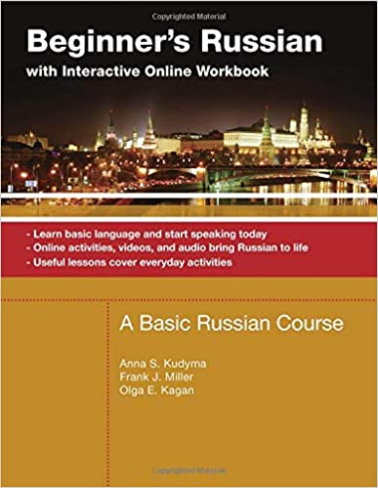


What is in use? KUDYMA

Slide 4
What I had in a readily accessible format

Slide 5
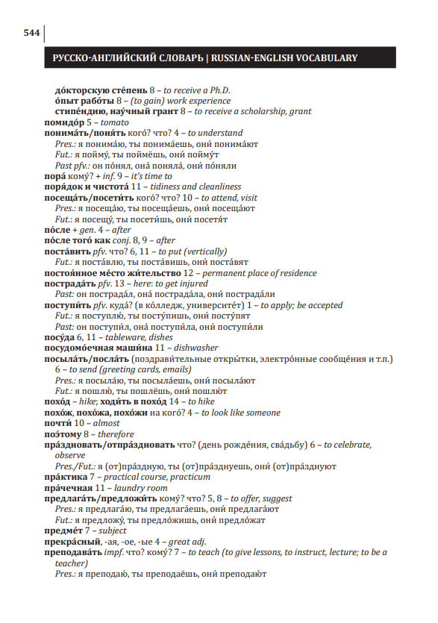
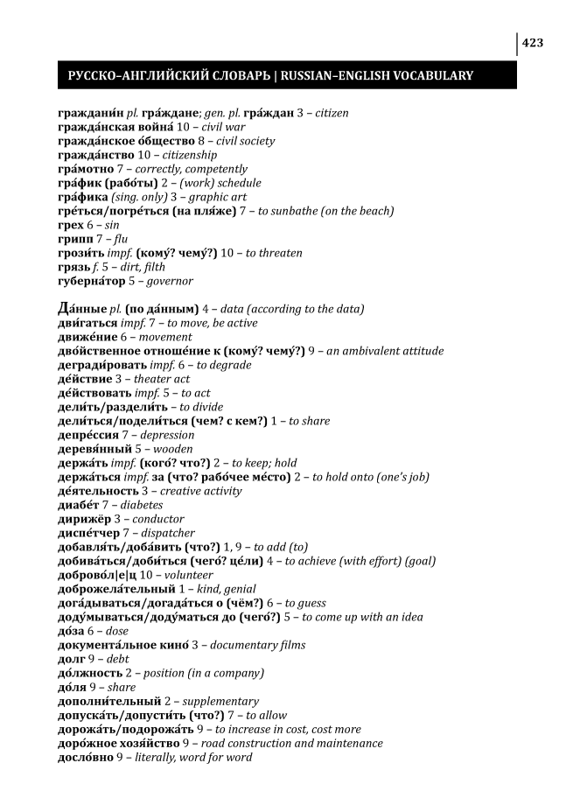
Examples of the Data - in PDFs no less

Slide 6
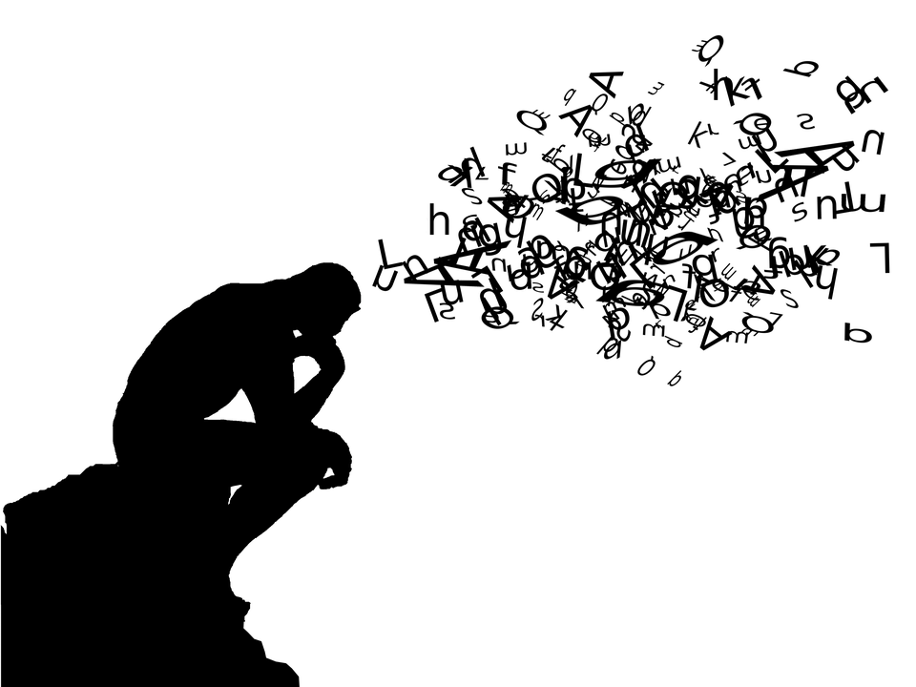
Guiding thoughts
Have you ever looked in a textbook and thought,
“Why are they teaching that?”
How much of targeted vocab is “useful?”
How can “usefulness” be operationalized?
Is vocab “useful” across levels?

Slide 7
Hypotheses
Learner proficiency vis. Lexical development
Frequency plays an effect on the development of learner language proficiencies
In the wild, words are used with differing frequency ->
this often has an effect on:
the ease with which lexical items are acquired (although classroom frequency =/= rw frequency)
Lexical diversity at different levels
Ostensibly, lower level learner vocab should have greater proportion of frequent words
High level learner vocab should have increased proportion of less frequent words

Slide 8

Sounds like a great project, right?

Slide 9
Wrong

Slide 10

My initial RQs
Is this born out realistically?
What are the proportions of high-low frequency words/collocations being targeted according to level?
Pedagogically, it makes sense to target the items that students will need to understand early, thoroughly and broadly
Low frequency band (Highly frequent) items both likely and expected
Do these proportions change according to level?
As students’ proficiency increases we expect lexical diversity to increase (in fact that is a measure of increased proficiency)
Thus an increased proportion of high frequency band (Infrequent) items is anticipated and desired

Slide 11

!Spoiler Alert!
I didn’t answer these questions

Slide 12

Attempt #1
I tried to use a package called pdfPlumber to read in the pdfs
Sounds logical right? Wrong.
I tried to see what could be done with cyrillic encoding with this kind of package
Spoiler alert: it didn’t work
A setback for sure so time to come up with another plan…

Slide 13

Attempt #2
As it turns out, you can copy and paste the pdfs to plain text :D
Except even once you do it’s far from perfect :(
However, slowly but surely we’re getting closer
Me when everything continually goes wrong

Slide 14
Examples
(show files)

Slide 15
Contending with junk
Here is where my best friends came in
Commandline + Grep <3
(show console)

Slide 16
Attempt #3 - My progress thus far
With cleaner data I was able to read the files into jupyter nb
I was able to split on \n line and create dictionary lists (check)
I used regex to take out the page info I didn’t need (most of it)
I converted my lists to data frames
Split on the ‘-’ character used to delineate entry from translation
Extended that split info into two labeled columns
Broadcast textbook level label as a new column for each data frame
Combined, dropped na rows, and sorted based on Russian entry

Slide 17
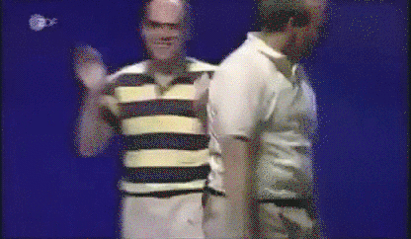

Slide 18

But wait, there’s more (bad news)
The frequency list I was able to procure, unfortunately, is built on inflected forms
I don’t have the time or resources to create lemmatized lists of my data or the frequency data to make any conclusions in that way…
Shit happens

Slide 19
Where you come in
Do you think there is a way that I could use morphological material I can find on line to define a function using regex to return a part of speech tag for each entry?
For example verbs end in a handful of ways in Russian ить|ыть|ать|ять|еть|сти
However adverbs end in o and that tends also to be a neuter noun marker
Is there a way to use regex to match specifically with the end of a line?
a lot of the entries are collocates so if its a adj + noun collocate I need to make the entry for the head - this is not an issue for front headed collocates like predicate + argument
Would it be ok to just label manually, then run my stats?

Slide 20
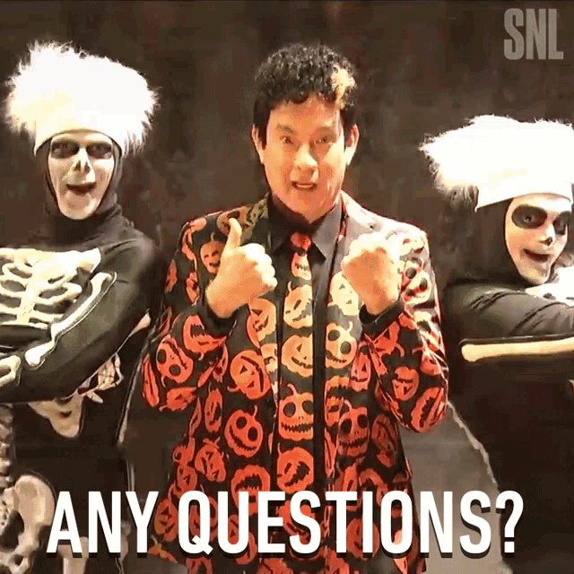

Slide 21
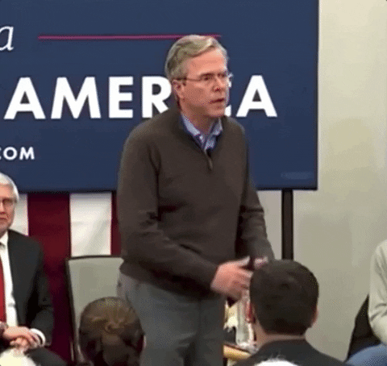
Thank you

